Slide 1
Enron North America Gas Logistics
An Overview

Slide 2
Gas Logistics Introduction
Gas Logistics is part of the Energy Operations group under the Enron Networks organization.
Partners with the Commercial, Origination and Settlements teams to optimize value and minimize operational risk.

Slide 3
Gas Logistics Introduction
Responsible for the scheduling of all physical transactions.
Coordinates movement of gas across national pipeline grid.
Acts as bridge between Commercial desks and Settlements team.
Works to minimize operational risk and identify opportunities to add value.
Coordinates operational issues & acts as liaison for asset management customers.

Slide 4
Timely/Intraday Nomination Timeline
(All Times Central Clock Time)
Calendar Day 10th
Gas Day 11th
Evening*
Bump
6:00 PM
12 AM
12 AM
Timely*
11:30 AM
9:00 AM
3:30 PM
4:30 PM
9:00 PM
10:00 PM
Timely Noms due
for Gas Day 11th
Timely
Operator
Confirmation
Timely
Scheduled
Quantities
Available
Evening
Noms due
Evening
Operator
Confirmation
Evening
Scheduled Quantities
Available
Calendar Day 11th
12 AM
Intraday 1*
Bump
10:00 AM
Gas Day 11th
Intraday 2*
5:00 PM
12 AM
9:00 AM
1 PM
2:00 PM
8:00 PM
9:00 PM
Gas Day ends
11th begins
Intraday 1
Noms due
(Gas Flow to
begin @ 5:00pm)
Intraday 1
Operator
Confirmation
Intraday 1
Scheduled
Quantities
Available
    Intraday 2
    Noms due
    (Gas Flow to
    begin @ 9:00pm)
Intraday 2
Operator
Confirmation
Intraday 2
Scheduled
Quantities
Available
Calendar Day 12th
12 AM
Gas Day 11th
12 AM
9:00 AM
9:30 AM
Gas Day
11th ends
Final
Scheduled
Volumes
Available
*Allow 15 minutes for EDI/EDM

Slide 5
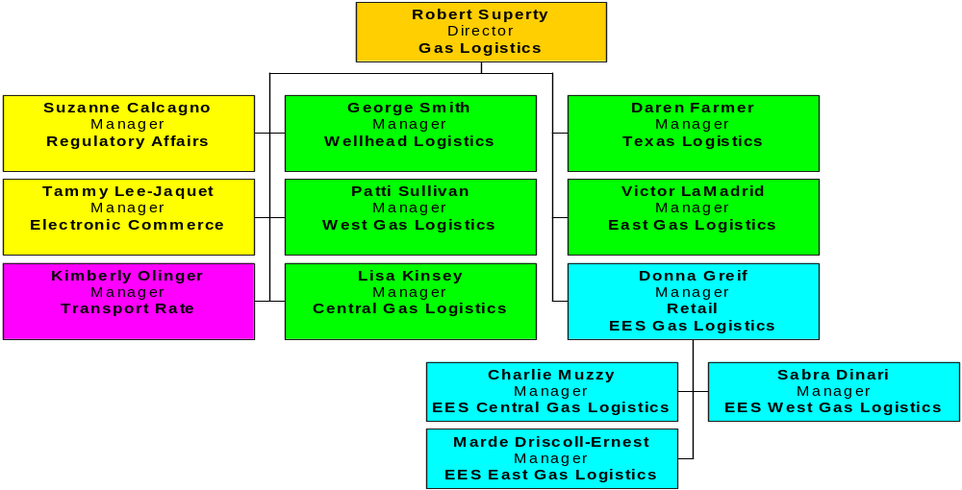
Gas Logistics

Slide 6

Gas Logistics Headcount
Traders = 57
Schedulers = 80+

Slide 7
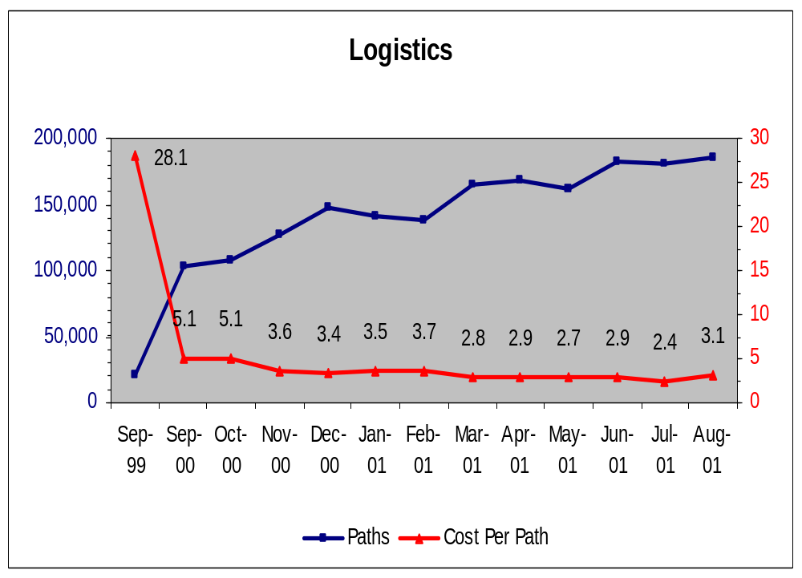
Logistics: Number of Paths & Cost Per Path
Since September 1999 the Cost per Path has decreased as the Number of Paths has increased.

Slide 8
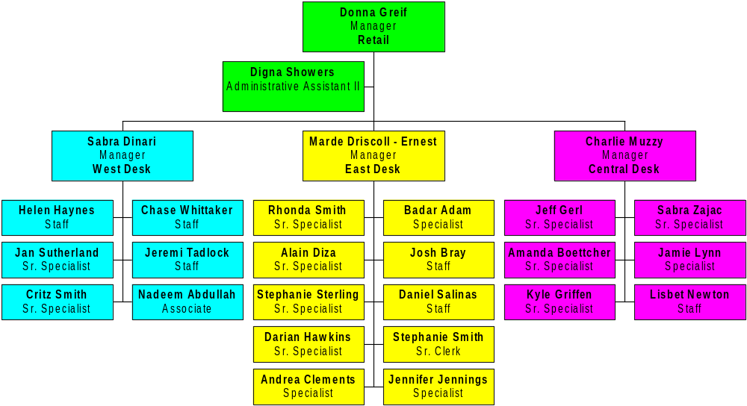
EES Gas Logistics

Slide 9
EES Gas Logistics Information
Manages an excess of 16,000 deals supplying gas to approximately 15,000 counterparts.
Nominations sent to approximately 30,000 meters on approx. 30 pipelines and behind approx. 100 LDC’s.
Customer account management includes load forcasting, consumption management, daily & monthly account balancing, daily scheduling, internal deal pricing and volumetric capture across 4 un-integrated systems, as well as storage and synthetic storage account management.
Establishes, communicates, and confirms delivery instructions with buyers and sellers.
Receives invoices relating to product transportation & reviews economic terms.

Slide 10
EES Gas Logistics Information
Support commercial teams – daily intelligence gathering, including pipeline information, position worksheets, storage levels, and any other data deemed critical or useful to traders/originators.
Monitor day forward trades to ensure books are flat
Monitor trading activities (internal & external)
Resolve issues that stem from trading (bridge monitoring)
Report daily, monthly, year to date, etc. . .trading activities.

Slide 11
EES East Gas Logistics Pipelines
& LDC's
Algonquin Gas Transmission Company
Allegheny Power
Atlanta Gas Light Company
Bay State Gas Company
Boston Edison
City of Olive Branch
Columbia Gas of Maryland, Inc.
Columbia Gas of Ohio, Inc.
Columbia Gas of Pennsylvania, Inc.
Columbia Gas of Virginia
Columbia Gas Transmission Corporation
Columbia Gulf Transmission
Commonwealth Gas
Connecticut Natural Gas Corporation
Consolidated Edison, Inc.
Consolidated Natural Gas Company
Crossroads Pipeline Company
Delta Natural Gas Company, Inc.
Dominion Hope
Elizabethtown Gas Company
Empire State Pipeline Company
Equitable Resources Inc.
Florida Gas Transmission Company
Iroquois Gas Transmission System L.P.
Jackson Energy Authority
Key Span Energy Delivery
KNG Energy, Inc.
Long Island Power Authority
Louisville Gas & Electric Company
Nashville Gas Company
National Fuel Gas Distribution Corporation
National Fuel Gas Supply Corporation
New Jersey Natural Gas Company, Inc.
New York State Electric & Gas Corporation

Slide 12
EES East Gas Logistics Pipelines & LDC's Continued
Niagara Mohawk Power Corporation
North Carolina Natural Gas Corporation
Northeast Ohio Natural Gas Corp.
PECO Energy Company
Penn Fuel Gas, Inc.
Pennsylvania Gas & Water Company
Peoples Natural Gas Company
Piedmont Natural Gas Company, Inc.
Public Service Company of North Carolina, Inc.
Public Service Electric & Gas Company
Rochester Gas & Electric Corporation
South Jersey Gas Company
Southern Connecticut Gas Company
Southern Natural Gas Company
TECO Peoples Gas
Tennessee Gas Pipeline Co.
Texas Eastern Transmission, LP
Texas Gas Transmission Corporation
The Cincinnati Gas & Electric Company
The Dayton Power & Light Company
The East Ohio Gas Company
The Providence Gas Company
The Union, Light, Heat & Power Company
Transcontinental Gas Pipe Line Corporation
UGI Corporation
Virginia Natural Gas, Inc.
Washington Gas Light Company
Western Kentucky Gas Company
Yankee Gas Services Co, Inc.

Slide 13
EES West Gas Logistics Pipelines
& LDC's
Amarillo Natural Gas, Inc.
El Paso Natural Gas Company
Gulf South Pipeline Company, LP
Long Beach Gas & Electric Dept.
Northwest Natural Gas Company
Pacific Gas & Electric Company
PG & E Gas Transmission, Northwest Corporation
Public Service Company of Colorado
Public Service Company of New Mexico
Puget Sound Energy
Questar Gas Co.
San Diego Gas & Electric Company
Southern California Gas Company
Southern Union Company
Southwest Gas Corporation
Transwestern Pipeline Company
TXU Gas Distribution (formerly Lone Star)
Williams Gas Processing Company

Slide 14
EES Central Gas Logistics Pipelines
& LDC's
AmerenUE
ANR Pipeline Company
Arkansas Oklahoma Gas
ATCO Midstream
Central Illinois Light Company
Central Illinois Public Service Company
CMS Trunkline Gas Company
Consumers Energy Company
Dominion Peoples
Enbridge Consumers Gas
Enbridge Midcoast Energy, Inc.
IES Utilities, Inc.
Illinois Power
Indiana Gas Company, Inc.
Kansas Gas Service Company (a division of Oneok, Inc.)
Laclede Gas Company
Madison Gas & Electric Company
Michigan Consolidated Gas Company
Michigan Gas Utilities, a Division of Utilicorp United Inc.
MidAmerican Energy Holdings Company
Mississippi River Transmission Corporation

Slide 15
EES Central Gas Logistics Pipelines & LDC's Continued
Missouri Gas Energy
Missouri Public Service
Natural Gas Pipeline Company of America
Nicor Gas
North Shore Gas Company
Northern Indiana Public Service Company
Northern Natural Gas Company
Oklahoma Natural Gas Co.
Oneok Gas Transportation, LLC
Panhandle Eastern Pipe Line Co.
Peoples Natural Gas
Reliant Energy Arkla
Reliant Energy Gas Transmission Company
SEMCO Energy Gas Company
St. Joseph Light & Power Co.
The Peoples Gas Light & Coke Company
Timbers Gas
Transcanada Pipelines Limited
Union Gas Limited
United Cities Gas Company
Williams Gas Pipelines Central, Inc.
Wisconsin Electric Power Co.
Wisconsin Gas Company
Wisconsin Public Service Corporation

Slide 16
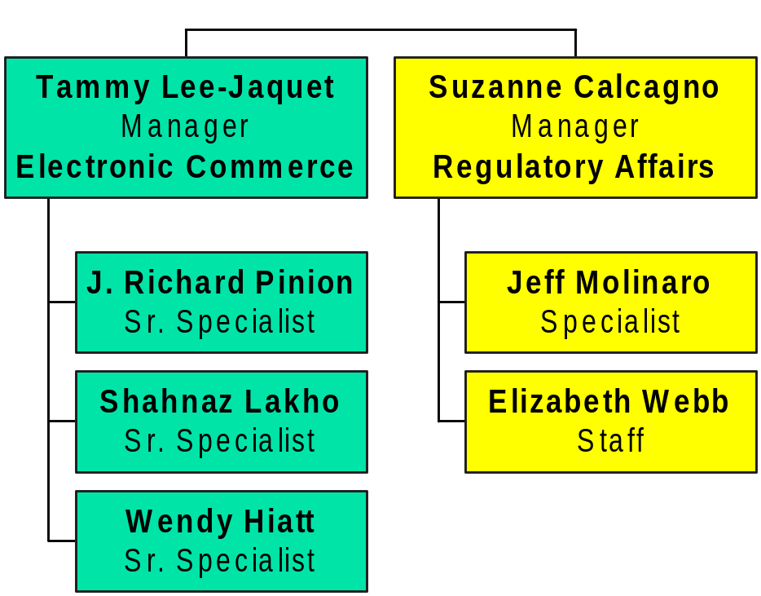
Electronic Commerce/Regulatory Affairs

Slide 17
Electronic Commerce Information
Exchanging electronic files with 36 pipelines. EDI X12 on 30 pipelines and proprietary files on 6 pipelines.
Majority of gas business is scheduled through the use of EDI (approx. 75%).
Average number of EDI transactions
  Per day 1,013
  Per month 31,430
  Per year 377,160
Expected electronic transaction growth of 15% with EES.
ENA is 85% of the files and 40% of the transactions through the Enron EDI Corporate Hub.

Slide 18
Regulatory Affairs Information
Acts as liaison between Government Affairs and the Logistics & Commercial teams.
Monitors pipeline tariff changes to advocate on behalf of Enron for favorable operating conditions.
Communicates changes in FERC Policy and in pipeline services to Commercial & Logistics.
Responsible for all Regulatory reporting relating to Enron’s import and export of natural gas.
Handles FERC data requests and other ad hoc data requests.

Slide 19
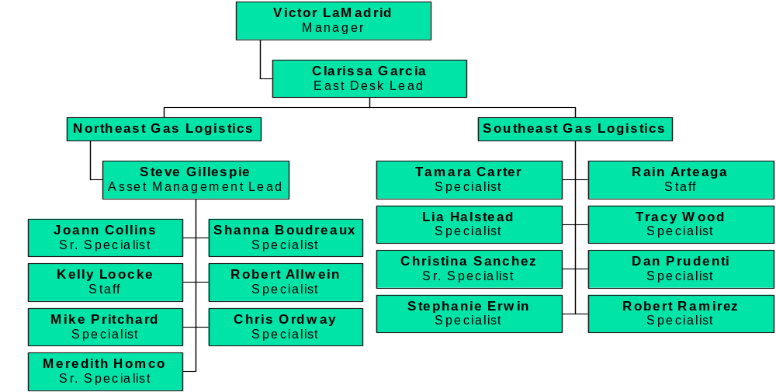
East Gas Logistics

Slide 20
Southeast Pipelines
Average Daily Throughput 5.4 BCF supply & 5.4 BCF market
Acadian Pipeline
Bridgeline
Cavallo Pipeline
Chandeleur Pipe Line
Citrus
Columbia Gulf
Cyprus
Destin
Discovery
Florida Gas
Garden Banks
Green Canyon Pipeline
KOCH Gateway/United
KOCH Midstream
Leviathan Gas
Louisiana Intrastate Gas
MOPS – Florida
Sabine Pipeline
Sabine Hub
Sea Robin
South Georgia Pipeline
Southern Natural
Tennessee
Stingray
Texas Gas Transmission
Venice Gas Gathering System

Slide 21
Northeast Pipelines
Average Daily Throughput 5.4 BCF supply & 5.4 BCF market
Alabama Tennessee
Algonquin
Central Texas Gathering System
Columbia Natural Resources
Columbia Gas of Kentucky
Columbia Gas Transmission
Consolidated Natural Gas
Cove Point
Eastern American Energy
Eastern States Energy
East Ohio Gas
East Tennessee
EGSI (Exxon)
Equitran
Gatherco
Hattiesburg Storage
Iroquois
Marco
National Fuel
New Waskom
Norse
Olympic Pipeline
Somerset
Texas Eastern
Transco
Transco Louisiana Intrastate

Slide 22
East: Asset Management Deals
Virginia Natural Gas (owned by Atlanta Gas Light) – Peak delivery of 330,000 Mmbtu/day with transport & storage assets on:
  Columbia Gas
  Columbia Gulf
  Dominion
  Cove Point Storage
  Tennessee
  Transco

Slide 23
East Gas Logistics Information
Southeast – average daily throughput is 5.2 BCF of supply transactions & 5.2 BCF of market transactions.
Northeast – average daily throughput is 5.6 BCF of supply transactions & 5.6 BCF of market transactions.
Logistical interactions include internal & external groups such as origination, structuring, trading, volume management, settlements, deal validation, deal confirmation, global, risk, external pipeline personnel & external industry counter parties.
Approx. 80 % of transactions are via Enron Online on a daily basis on the East desk
Majority of deals are day spot transactions, followed by base load deals, & finally term deals.

Slide 24
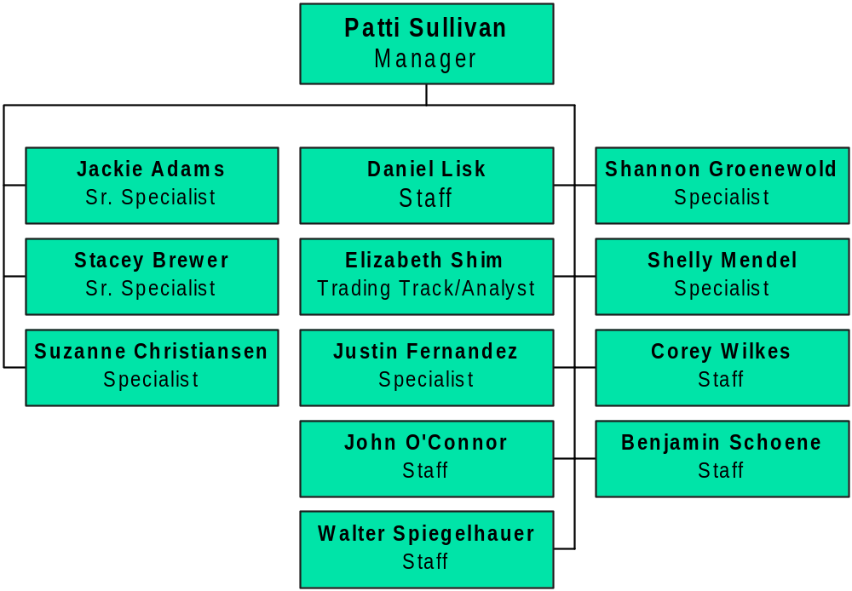
West Gas Logistics

Slide 25
West Pipelines
Colorado Interstate
El Paso Natural Gas
Fort Union (FUGG)
Hub Services (Park)
Kern River
Lost Creek (LCG)
Mojave Pipeline
Montana Power
Northwest Pipeline
Pacific Gas & Electric
Pacific Gas Transmission
Public Sevice of Colorado
Questar
Rulison Gas Company, LLC
SoCal Storage
Southern California Gas
Sumas (SIPI)
Trailblazer Pipeline
Transcolorado
Transwestern
Williston Basin
Wyoming Interstate Co.
Williams Field Services

Slide 26
West Gas Logistics Information
Total daily physical volumes range from 7 to 10 bcf a day.
Approximately 90 to 95% of physical trades are EOL deals.

Slide 27
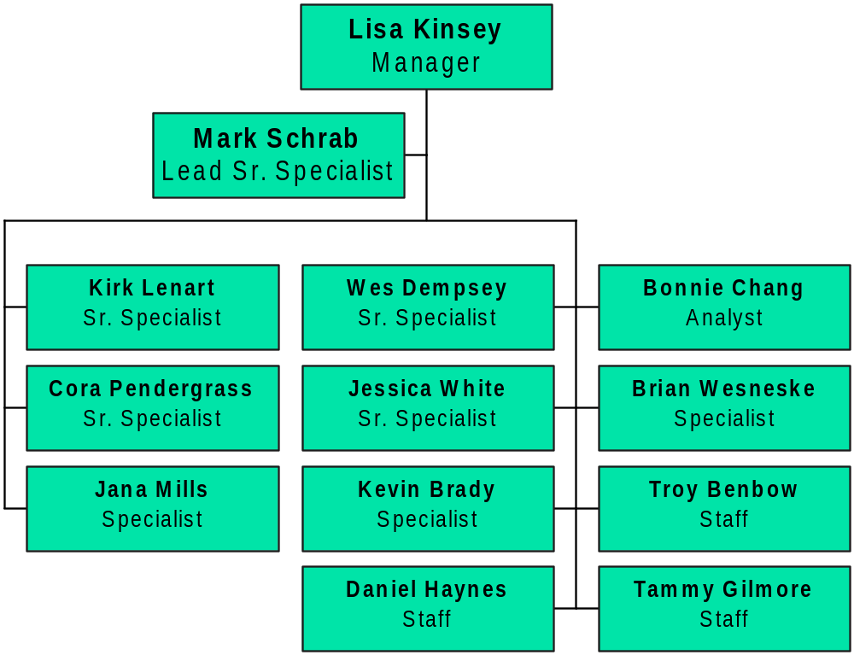
Central Gas Logistics

Slide 28
Central Pipelines
ANR Field Services
ANR Pipeline
Consumer’s Energy Co.
Empire
Enogex
Enron Gas Gathering
GPM Gas/GPM
Great Lakes Gas Transmission
Michcon
Mississippi River
Natural Gas Pipeline
Northern Border
Northern Natural Gas
Northern Illinois Gas Company
Northern Indiana Public Service Co.
Oklahoma Natural Gas
Panhandle Eastern Pipeline
Panhandle Field Services
Reliant Energy Field Services
Reliant Energy Gas Transmission
The People’s Gas Light & Coke
Transok
Trunkline
Williams Natural Gas

Slide 29
Ontario Pipelines
Ontario Region
  Transcanada Pipeline
  Union Gas Pipeline

Slide 30
Central: Asset Management Deals
The People’s Gas Light & Coke Company – Manage transportation for:
  Peoples Gas Light & Coke Company & Northshore Gas Company on Northern Border Pipeline (approximately 261,000 Mmbtu/day).
  Natural Gas Pipeline (64,400 Mmbtu/day summer), 114 Mmbtu/day winter).

Slide 31
Central Gas Logistics Information
Average transactions approx. 10 BCF
Logistical interactions include internal & external groups such as origination, structuring, trading, volume management, settlements, deal validation, deal confirmation, global, risk, external pipeline personnel, & external industry counter-parties.
Approximately 90% of all transactions are via EnronOnline on a daily basis for the Central Desk.
Majority of deals are daily spot transactions, followed by base load deals and finally, term deals.

Slide 32
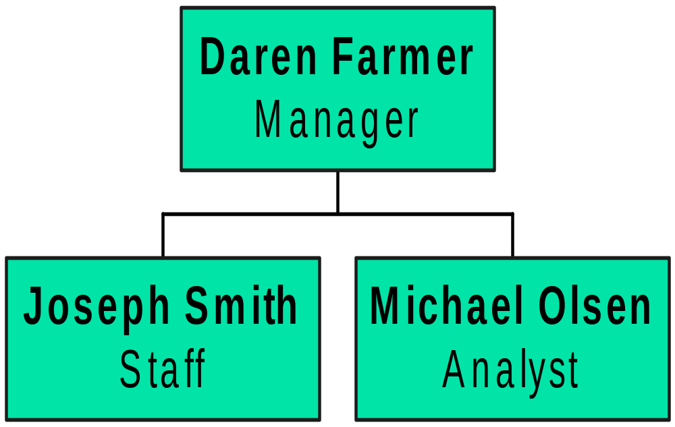
Texas Gas Logistics

Slide 33
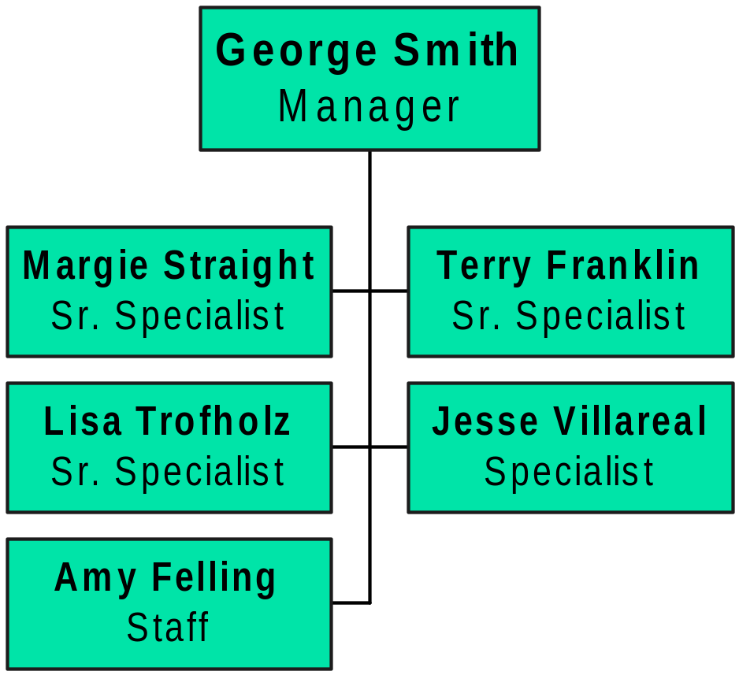
Wellhead Gas Logistics

Slide 34
Texas Pipelines
Amaco Pipeline
Black Marlin (Blue Dolphin)
Channel Pipeline
Dow Pipeline
Duke Energy Guadalupe
East Texas Gas (ETXC)
EasTrans Pipeline
Houston Pipeline
Lone Star (TXU Gas Dist.)
Moss Bluff Storage (MOSS)
NNGB (formerly Black Marlin)
Oasis Pipeline (OPLC)
Pan Grande
PGE
PowerTex (LG&E Nat)
Sea Hawk-Seagull Shoreline
TUFCO
Winnie Pipeline (Centana)

Slide 35
Wellhead Pipelines
Central Region
ANR Pipeline
HIOS
MOPS
Natural Gas Pipeline
NorAm Field Services
NNG
NorAm (ARKLA)
ONG
PEPL
Trunkline
UT Offshore
Northeast Region
Central Texas Gathering
Columbia Gas Transmission
Columbia Gulf
Tennessee Gas
Texas Eastern
Transco
Venice Gas Gathering
Southeast Region
Discovery
Florida Gas
KOCH Gateway/United
KOCH Midstream
Southern Natural
Tennessee
Stingray
Texas Gas Transmission

Slide 36
Texas Gas Logistics Information
Over 600,000 Mmbtu in daily physical volumes
Currently in a re-building phase – adjusting from an asset based trading organization (with Houston Pipe Line) to a strictly marketing organization
Increasing Enron’s presence in non-liquid trading areas, partnering with pipelines that were previously our competitors
90% of physical trades currently transacted on EOL, expect to decrease that percentage
Notes:
None at this time.

Slide 37
Wellhead Gas Logistics Information
Staff of 3 full time schedulers handling over 900,000 Mmbtu/day on 30 pipes.
Notes:
Staff of (3) full time schedulers handling over 900,000 Mmbtu/d on 30 pipes.
This should be changed to Wellhead Logistics, Texas and Wellhead are no longer combined.

Slide 38
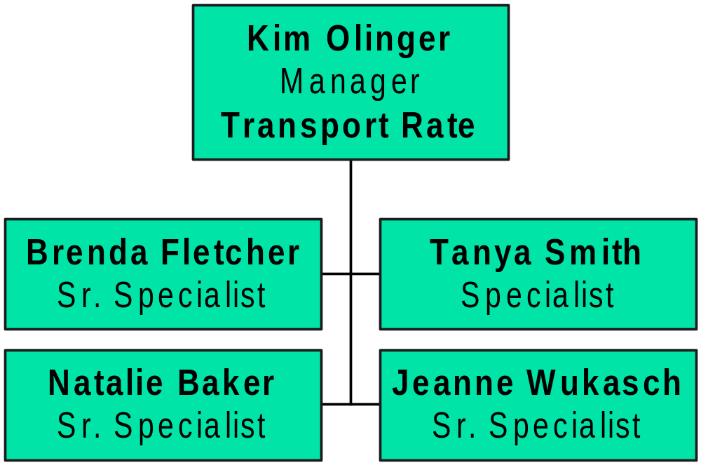
Transport Rate

Slide 39
Transport Rate Regions
West
Central
Southeast
Northeast
Texas

Slide 40
Transport Rate Information
Maintain & update all pipeline tariff & fuel rates in Unify.
Create/update transport capacity, storage, & usage tickets in Sitara.
Verify all transport invoices for accuracy of rates.
Responsible for flashing transport expense (demand, commodity, & reimbursements) that impacts p & l, general ledger, & O/A.
Work closely with schedulers on pathing & rate issues to prevent re-work.

